Slide 1


Tale Vibhag Shikshan Prasarak Mandal D.G.Tatkare Arts & Commerce College Tala Shri Manohar Keshav Randive Library (Knowledge Resource Center)
Library Orientation Programme
Year-2022-2023

Slide 2
About Library:
Tale Vibhag Shikshan Prasarak Mandal’s D.G.Tatkare Arts ‘Commerce College Library Named as ‘Shri Manohar Keshav Randive Library ‘established at 2001 years having collection of 8860 books, print journals and magazines, also college has subscribe N-List, E recourses database with e-books and e-journals.

Slide 3

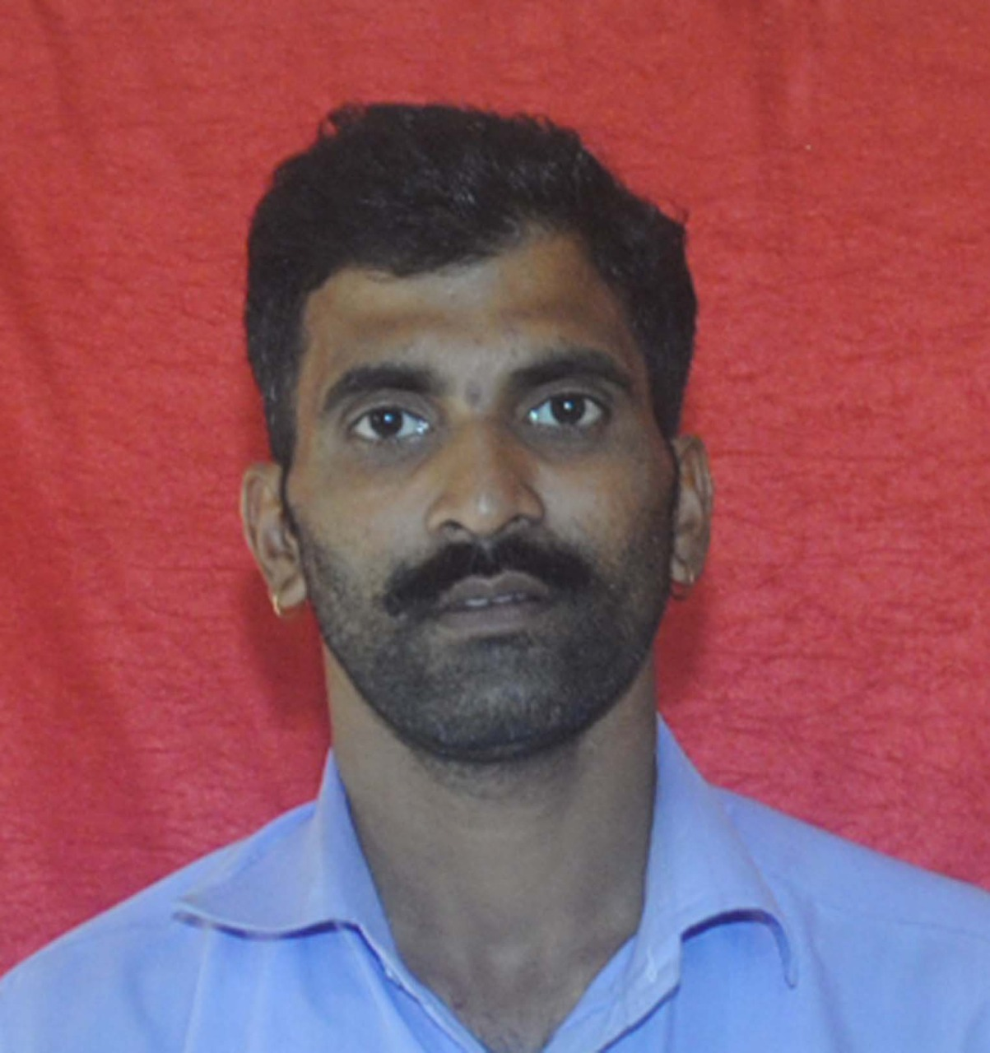
Library Staff
Sr.No | Name | Designation | Qualification | Photo
1 | Mr.Wadhawal M.J | Librarian | M.Lib & I.sc,B.ed. SET
2 | Mr.Polekar M.G | Lib.Attendant | B.A.M. Lib

Slide 4
LIBRARY ADVISORY COMMITTEE
Sr.No. | Name | Designation
1. | Dr.Lokhande B.M. (Principal) | President
2. | Prof. Wadhawal M.J. (Librarian) | Secretary
3. | Dr. Yadav N.S. | Member
4. | Dr. Kadam D.D. | Member
5. | Dr. Thorat R.M. | Member
6. | Mr. Mahajan V.M.(Head Clerk) | Member
7. | Mr.Polekar M.G.(Library Attd.) | Member
8. | Mrs.Salunke Siddhi Sahadev (Student) | Member
9. | Mr. Tambat Damesh DattaRam (Student) | Member
Sr.No. | Name | Designation
1. | Dr.Lokhande B.M. (Principal) | President
2. | Prof. Wadhawal M.J. (Librarian) | Secretary
3. | Dr. Yadav N.S. | Member
4. | Dr. Kadam D.D. | Member
5. | Dr. Thorat R.M. | Member
6. | Mr. Mahajan V.M.(Head Clerk) | Member
7. | Mr.Polekar M.G.(Library Attd.) | Member
8. | Mrs.Salunke Siddhi Sahadev (Student) | Member
9. | Mr. Tambat Damesh DattaRam (Student) | Member

Slide 5
Library Timing
-
Monday to Saturday | 7.30.00.AM to 6.00 PM
In exam Period | 7.30.00 A.M to 6.00 P.M.

Slide 6
Library Collections:
Sr.No. | Book Type | Total
1. | Text Books | 45869
2. | Reference Books | 7250
3. | Donated Books | 867
4 | Total Titles | 4416
5 | Total Number of books | 8860
6 | No. of E-journals | 6000 from N-LIST Database
7 | No. of E- Books | 1,99,500+ from N-LIST Database
8 | Journals and Magazine | 31
9 | News Paper | 7
10 | C.D./DVD/VCD | 123
11 | Back Volumes of Journals & Periodical | 25
12 | Maps | 35
13 | Encyclopedia Volumes | 55
14 | World Book | 23
15 | Braille Book | 65
16 | Specimen copy | 226

Slide 7
NEWS PAPER
Sr.No | Name Of The Paper
1 | Times of India
2 | Business Economics
3 | Maharashtra Times
4 | Loksatta
5 | Sakal
6 | Pudhari
7 | Raigad Times

Slide 8
Sr.No. | Magazine & Journals
1 | International Research Journals of Geography
2 | Udhyojak
3 | Samaj Prabhodhan Patrika
4 | Yojana Marathi
5 | Chanakaya
6 | Nokari Sandharbh-kolhapur
7 | Arthiniti
8 | Vanijya Vishwa
9 | Lalit
10 | Sadhana
11 | Pratiyogita Darpan
12 | Satyagrahi vichardhara
13 | Economic & Political Weekly(wpw)
14 | University News
15 | Vyapari Mitra
16 | Rojgar Nokari Sandharbh-Nagpur
17 | stree mukti Sanghatana
18 | Aksharprerani
19 | Aivaji
20 | Shikshan Sankraman-pune
21 | Marathi Akshardhara Parishad-Kolhapur
22 | Akshargatha-Nanded
23 | Marathi Abhyas Parishad Patrika
24 | Dhnayagangotri
25 | Andhashardha Nirmulan Patrika
26 | Indian Journal of Marketing
27 | Indian Journal of Finance
28 | Sadhana
29 | Prabandhan : Indian Journal of Management
30 | Arthshatra Indian Journal of Economics & Research
 | Vichar Manthan

Slide 9
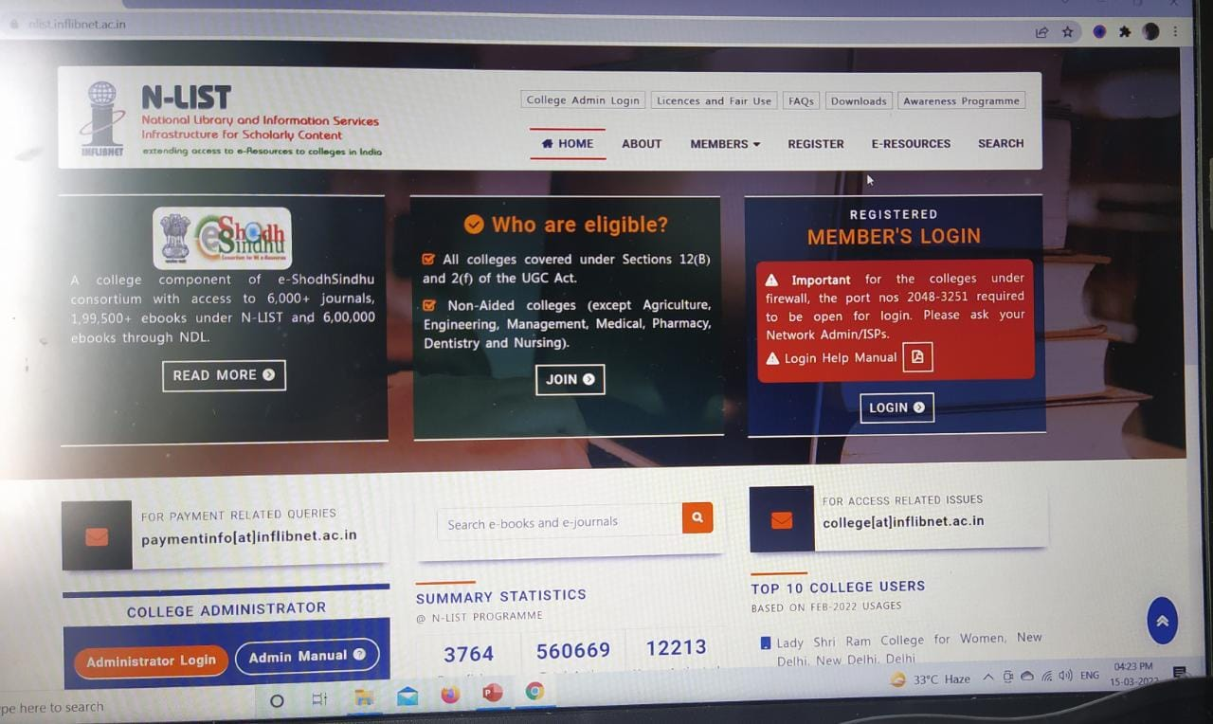
N-list-National Library & Information services Infrastructure for Scholarly Content (dgt123)
A college component of e-ShodhSindhu consortium with access to 6,000+ journals, 1,99,500+ ebooks under N-LIST and 6,00,000 ebooks through NDL.

Slide 10
Library Software
Sr No. | Name of the Software
01 | Library Automation- | E-Granthalaya
02 | Catalogue (OPAC) | 103.167.74.148/opac
03 | User Tracking System | Library In & Out Entry Report Software
04 | DSpace (Digital Library) | 103.167.74.148:8080/jspui
05 | N-List- Online Database of National Library & Information Science | 6000 E Journals 1,99,500 E Books

Slide 11
National Digital Library

Slide 12
swayam
E

Slide 13
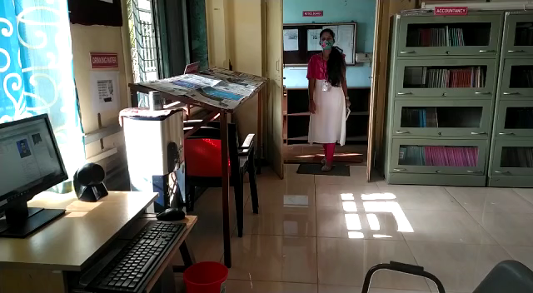
Library User Tracking System

Slide 14

LIBRARY WEBSITE
Dgtlibrary
Web opac
Other activity

Slide 15
Library Services & Amenities
Library Automation
WEBOPAC
Display of New Arrivals
News Paper Clipping
Free Wai Fai
Book Exhibition
Open Access
xerox /Print Facility
Bibliographic Services

Slide 16


